Slide 2
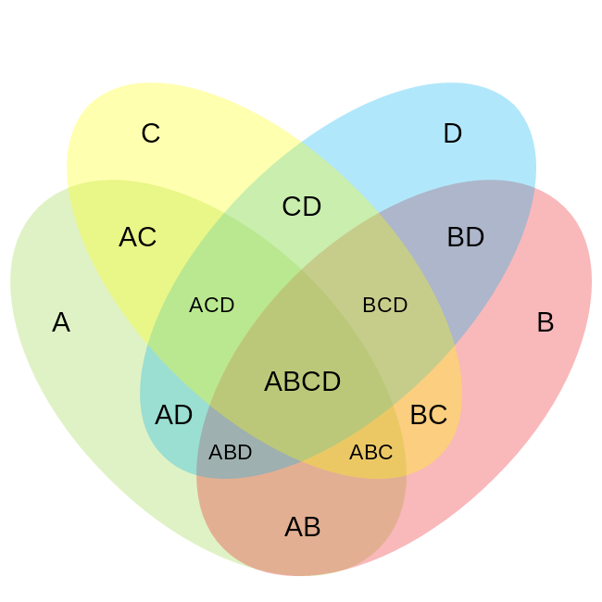
A = Meeting Attendees
B = EIP Authors
C = EIP Contributors
D = Client Contributors
N (Everyone Involved with Development) = 2,106
45
1011
94
64
61
25
46
106
196
16
63
235
21
45
78

